Slide 1
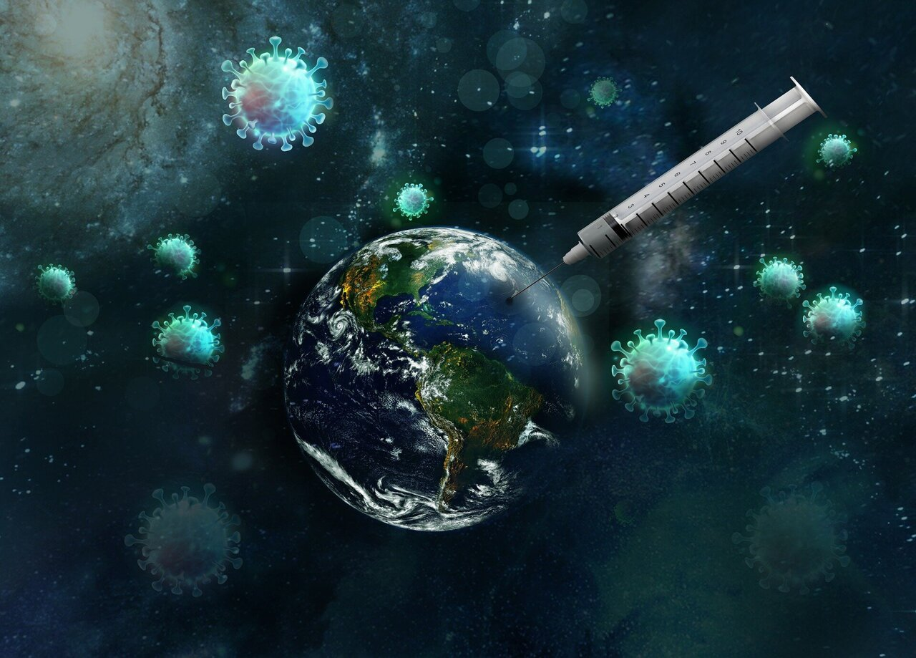
Introduction
COVID 19 vaccination trend analysis
Aim: Provide insights into global vaccination trends
Key focus areas: Number of people vaccinated, vaccines availability and country specific efforts
Notes:
Entered text
Slide 1:
The first slide showcases key statistics related to global vaccination progress. It includes an impactful image along with the following information:
- The global population fully vaccinated by 2022 reaches a remarkable milestone of 549 billion people.
- A total of 223 countries worldwide have participated in the vaccination efforts.
- The availability of 84 different vaccines has played a vital role in combating the pandemic.
Slide 2:
The second slide focuses on presenting the top 10 countries with the highest number of daily vaccinations. It features a graph visualizing the data, highlighting the daily vaccination rates. This visually engaging graph helps to compare and understand the varying vaccination efforts across different countries.
Slide 3:
The third slide incorporates a donut graph showcasing the vaccination progress of the top 5 countries. The graph is accompanied by informative details, such as the name of each country and the number of people vaccinated. This combination of visual representation and concise information provides a comprehensive overview of the vaccination status in these countries.
Additional Points:
- To enhance the overall presentation, you can consider adding a slide highlighting the percentage of the global population vaccinated.
- Including a slide that demonstrates the effectiveness and safety of vaccines can help educate and build trust among viewers.
- Consider incorporating a timeline slide to showcase the progress of vaccination efforts over a specific period, such as months or years.
- You can include a final slide summarizing the total number of vaccines administered globally, emphasizing the scale of the vaccination campaign and its impact on public health.

Slide 2
Global Vaccination Progress: Key Statistics and Country Comparisons
This presentation showcases key statistics related to global vaccination progress, including the number of fully vaccinated individuals, the number of participating countries, and the availability of vaccines. It also features Charts, graphs and Cards to compare the daily vaccination rates and progress of the top 5 and top 10 countries. Additional slides are added to highlight the percentage of the global population vaccinated, vaccine effectiveness and safety, a timeline of vaccination efforts, and the total number of vaccines administered globally.
: Global Vaccination Progress Presentation

Slide 3
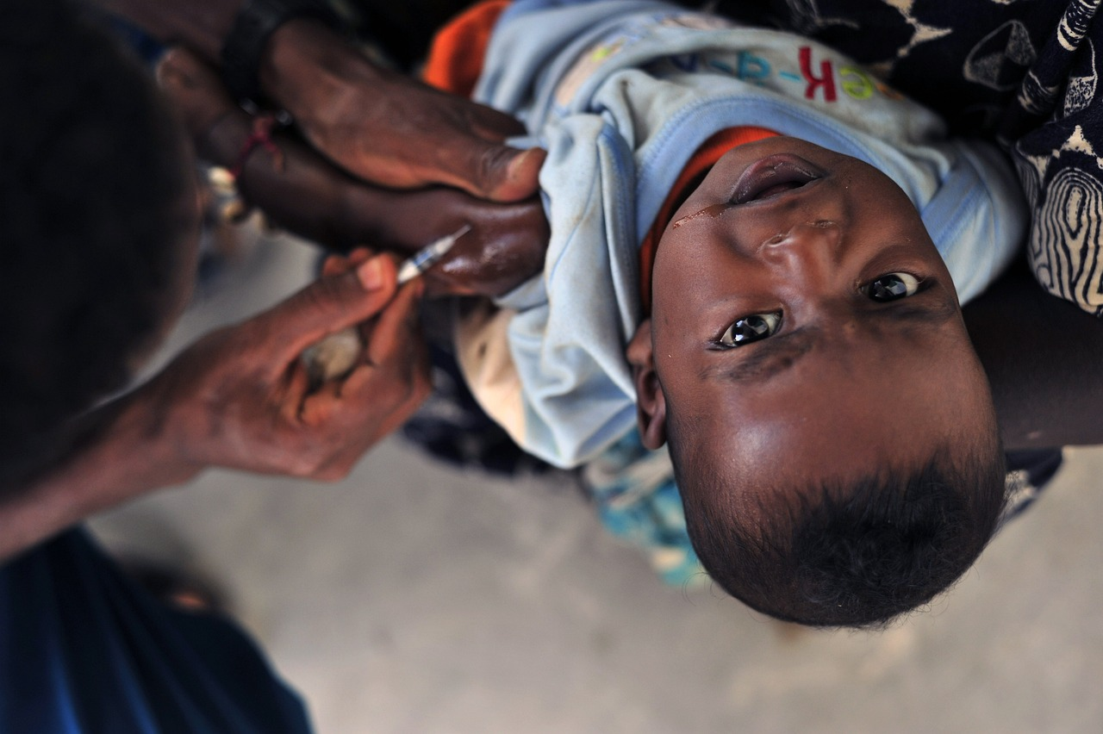
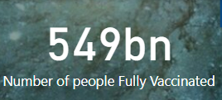
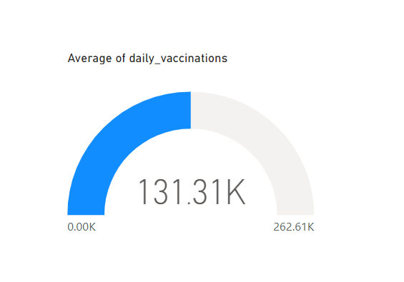
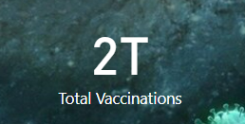
Global Vaccination Progress
Image showcasing the impact of global vaccination efforts.
549 billion people fully vaccinated by 2022.
223 countries worldwide participating in vaccination efforts.
Availability of 84 different vaccines playing a vital role in combating the pandemic.

Slide 4
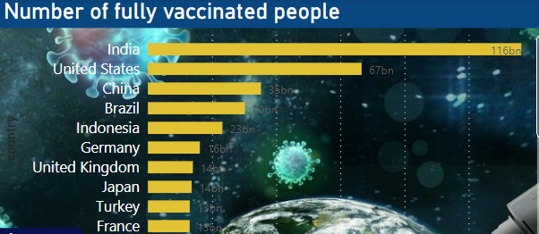
Top 10 Countries with Highest Daily Vaccinations
Graph showcasing the daily vaccination rates of top 10 countries.
Provides a visual comparison of vaccination efforts across different countries.

Slide 5
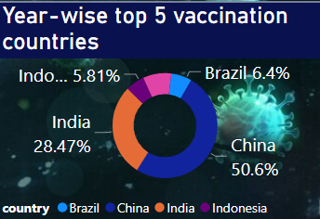
Vaccination Progress of Top 5 Countries
Donut graph showcasing vaccination progress of top 5 countries.
Provides concise information, such as the name of each country and the number of people vaccinated.

Slide 6
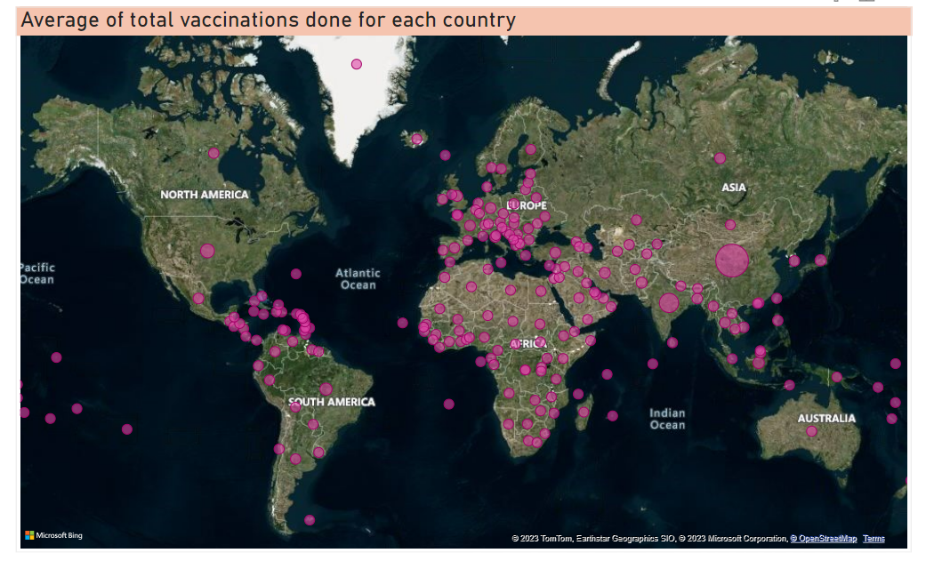
Global Population Vaccinated
A slide highlighting the average of the global population vaccinated.
Provides a clear understanding of the progress of vaccination efforts.

Slide 7
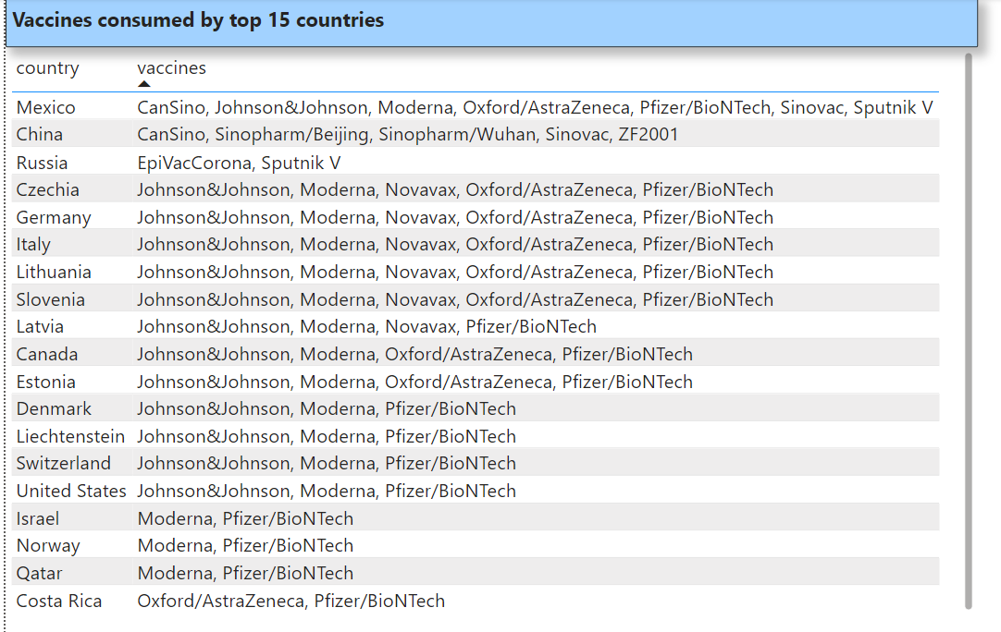
Vaccine Effectiveness and Safety
A slide demonstrating the effectiveness and safety of vaccines that were available during 2020, 2021, 2022 in various countries.
Educates and builds trust among viewers.

Slide 8

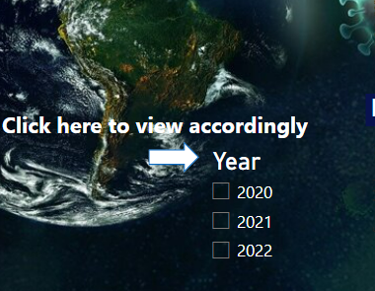
Vaccination Progress Timeline
A timeline slide showcasing the progress of vaccination efforts over a specific period.
Provides a chronological overview of vaccination efforts.

Slide 9

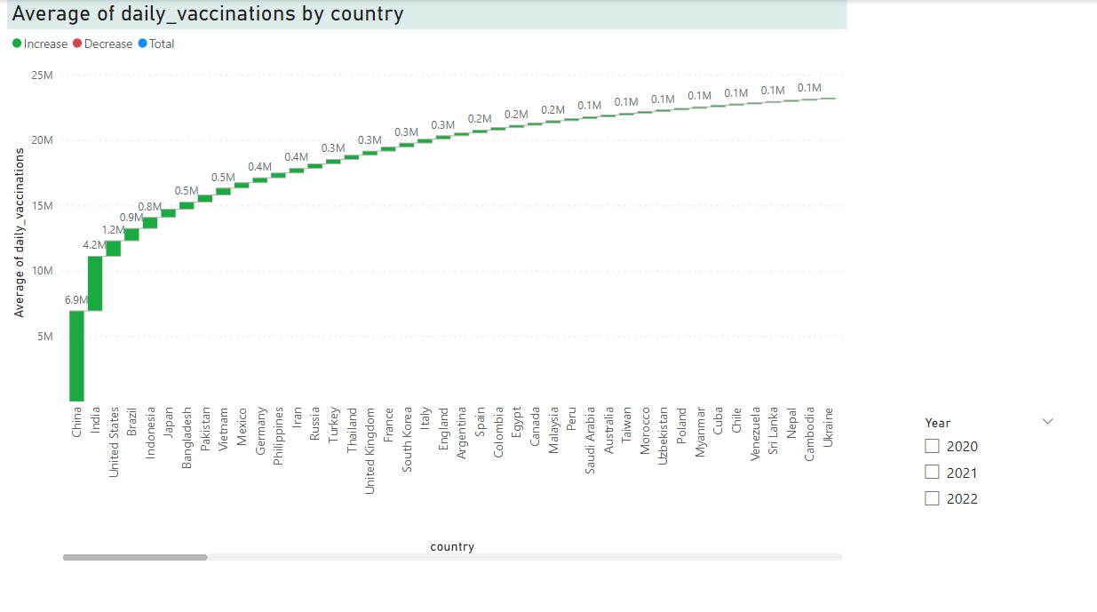
Year-wise Average Daily Vaccinations:
Waterfall chart representing the average daily vaccinations for each country over the years.
Identification of vaccination peaks and fluctuations to assess the progress of immunization campaigns.

Slide 10
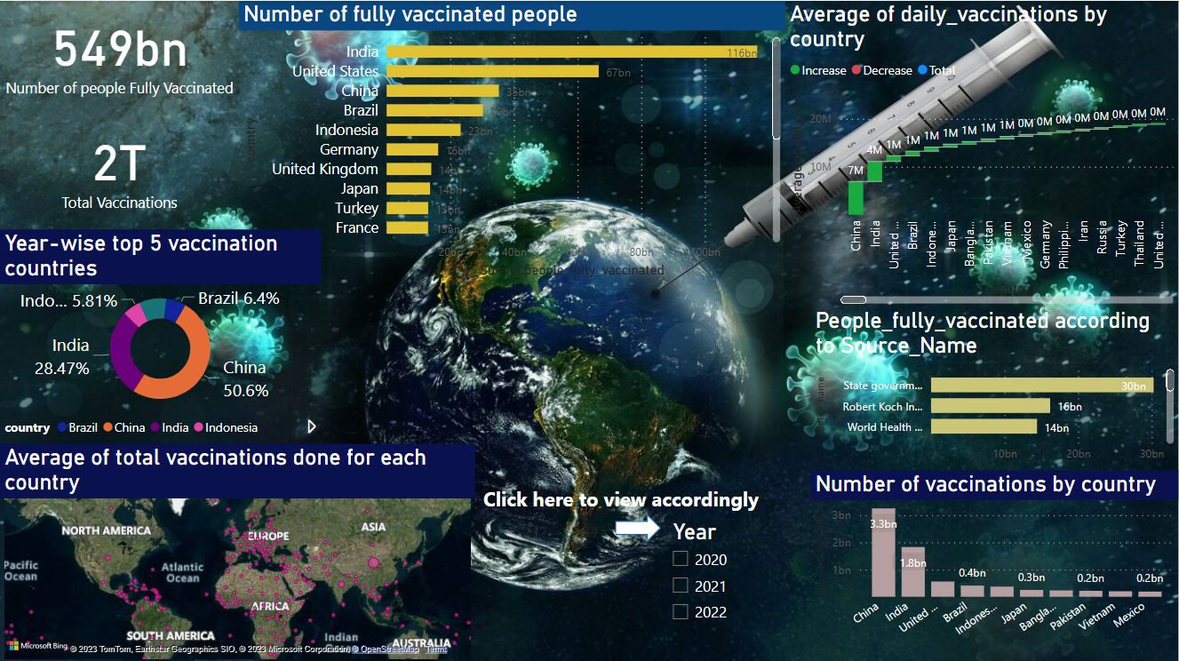

Slide 11
Thank you for your time and attention 🙂

